Slide 2
Theme Discourse Proverbs 4:23

Slide 3
Proverbs 4:23
Keep thy heart with all diligence; for out of it are the issues of life.

Slide 4
Proverbs 4:23
Keep thy heart with all diligence; for out of it are the issues of life.

Slide 5
Proverbs 4:23
Keep thy heart with all diligence; for out of it are the issues of life.
Strong’s #5341: To guard, protect

Slide 6
Proverbs 4:23
Keep thy heart with all diligence; for out of it are the issues of life.
Strong’s #3820: “The heart, also used figuratively very widely for the feeling, the will, and even the intellect; likewise for the center of anything.”

Slide 7
Proverbs 4:23
Keep thy heart with all diligence; for out of it are the issues of life.
As a man thinketh in his heart, so is he.
Proverbs 23:7

Slide 8
Proverbs 4:23
Keep thy heart with all diligence; for out of it are the issues of life.
Strong’s #4929: “A guard (the man, the post, or the prison).”

Slide 9
Proverbs 4:23
Keep thy heart with all diligence; for out of it are the issues of life.
Strong’s #8444: “exit, boundary, or deliverance”

Slide 10
Proverbs 4:23
Keep thy heart with all diligence; for out of it are the issues of life.
Strong’s #2416: alive”, “raw”, “fresh”, “strong”, and “life, whether literally or figuratively”

Slide 11
Proverbs 4:23
Keep thy heart with all diligence; for out of it are the issues of life.

Slide 12
Proverbs 4:23
Keep thy mind with all diligence; for out of it are the issues of life.

Slide 13
Ephesians 2:1-3
And you hath he quickened, who were dead in trespasses and sins;
Wherein in time past ye walked according to the course of this world, according to the prince of the power of the air, the spirit that now worketh in the children of disobedience:
Among whom also we all had our conversation in times past in the lusts of our flesh, fulfilling the desires of the flesh and of the mind; and were by nature the children of wrath, even as others.

Slide 14
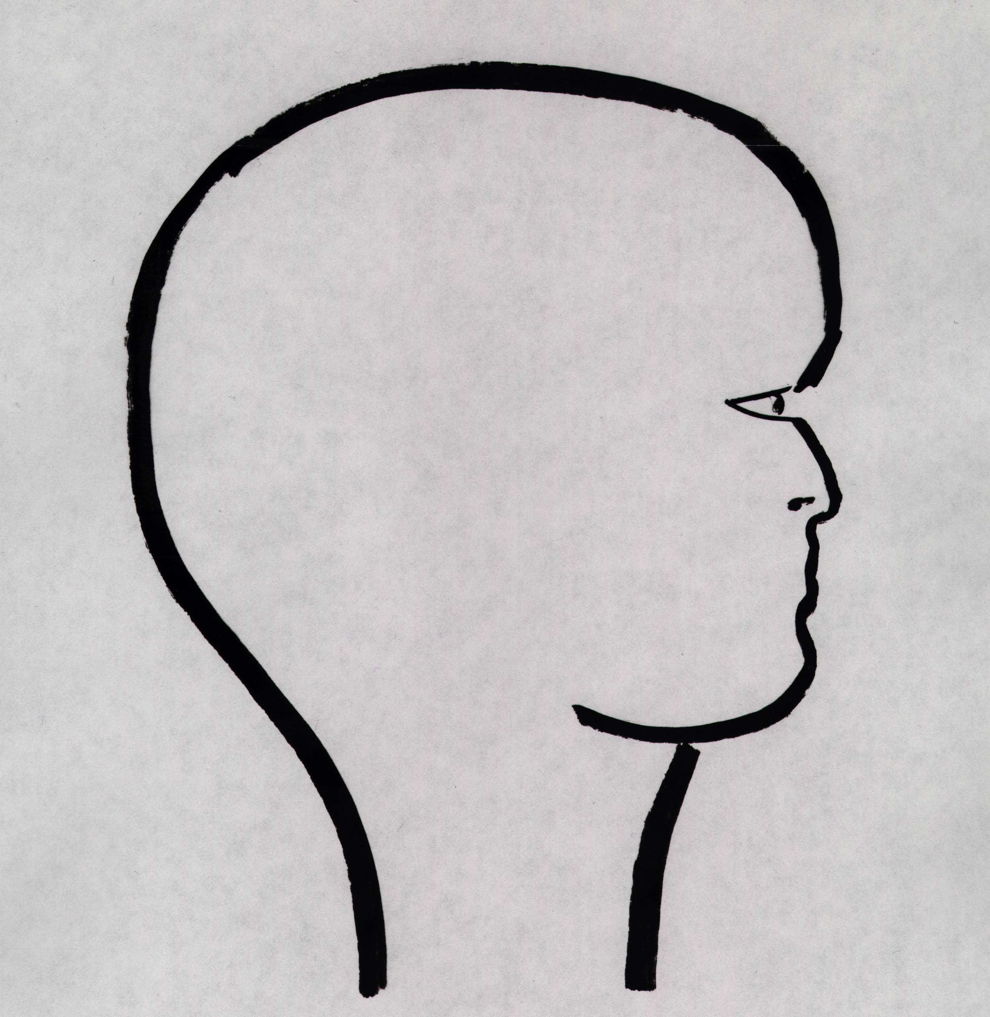

Slide 23
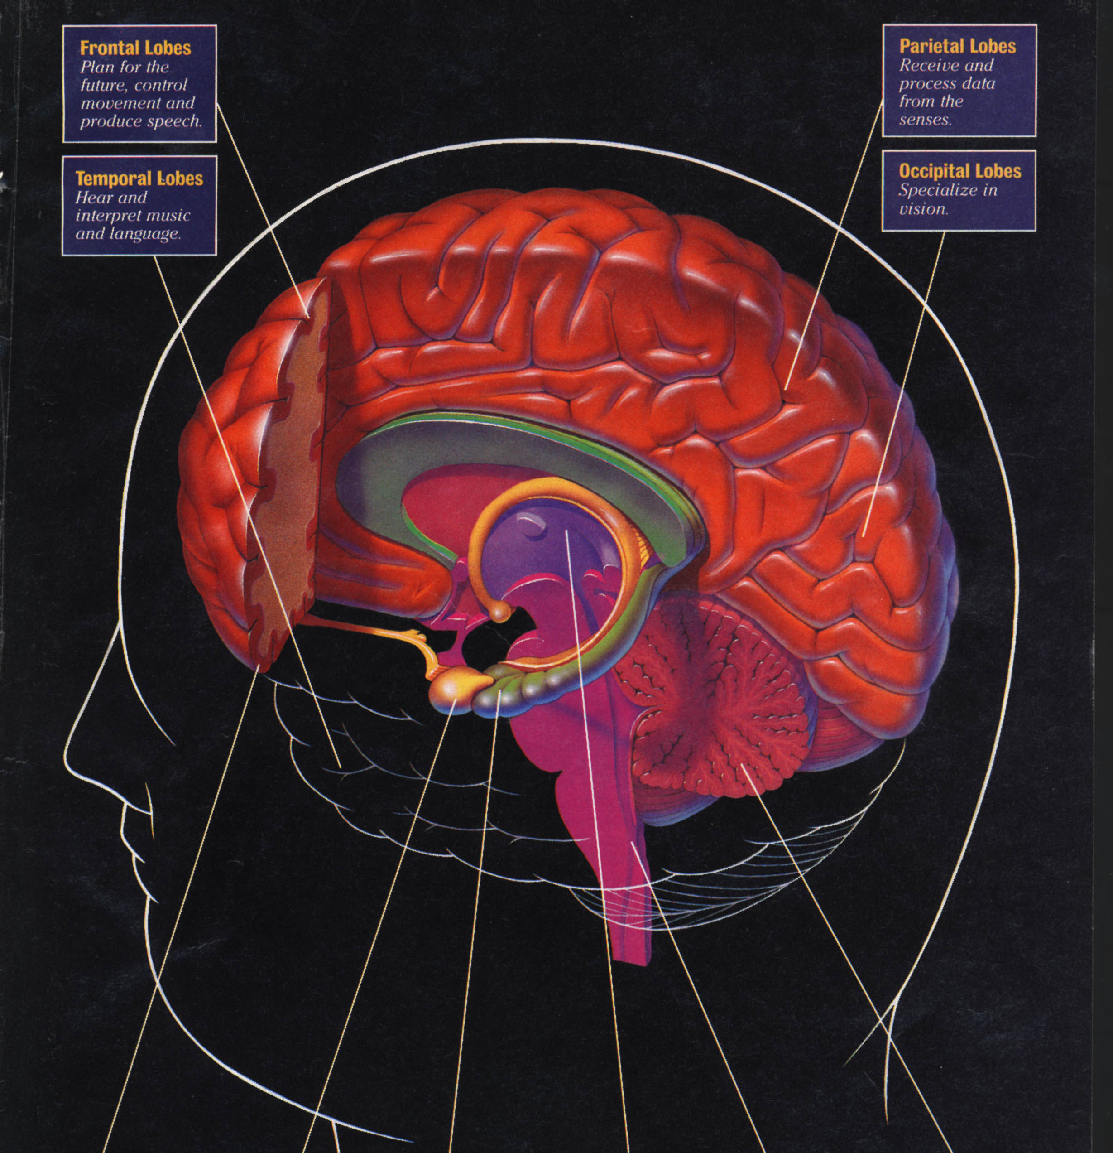

Slide 24
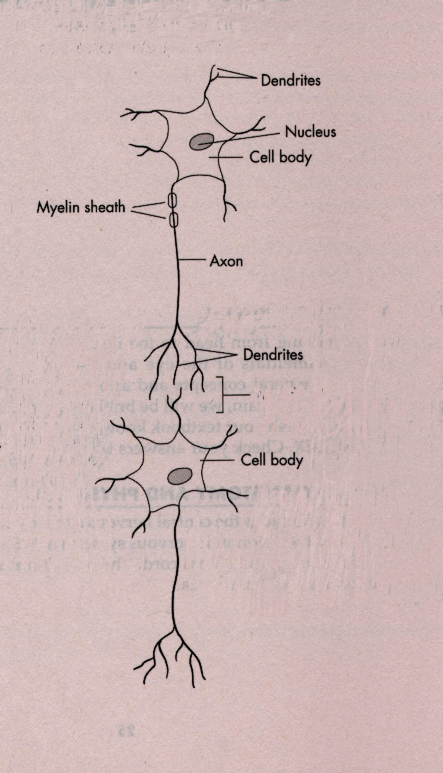
neuron
synapse
neuron

Slide 26
We are born in sin and shapen in iniquity
Psalms 51:5 (Paraphrased)

Slide 27
Romans 12:2
And be not conformed to this world: but be ye transformed by the renewing of your mind, that ye may prove what is that good, and acceptable, and perfect, will of God.

Slide 28
Philippians 2:5
Let this mind be in you, which was also in Christ Jesus:

Slide 29
John 6:38
For I came down from heaven, not to do mine own will, but the will of him that sent me.

Slide 30
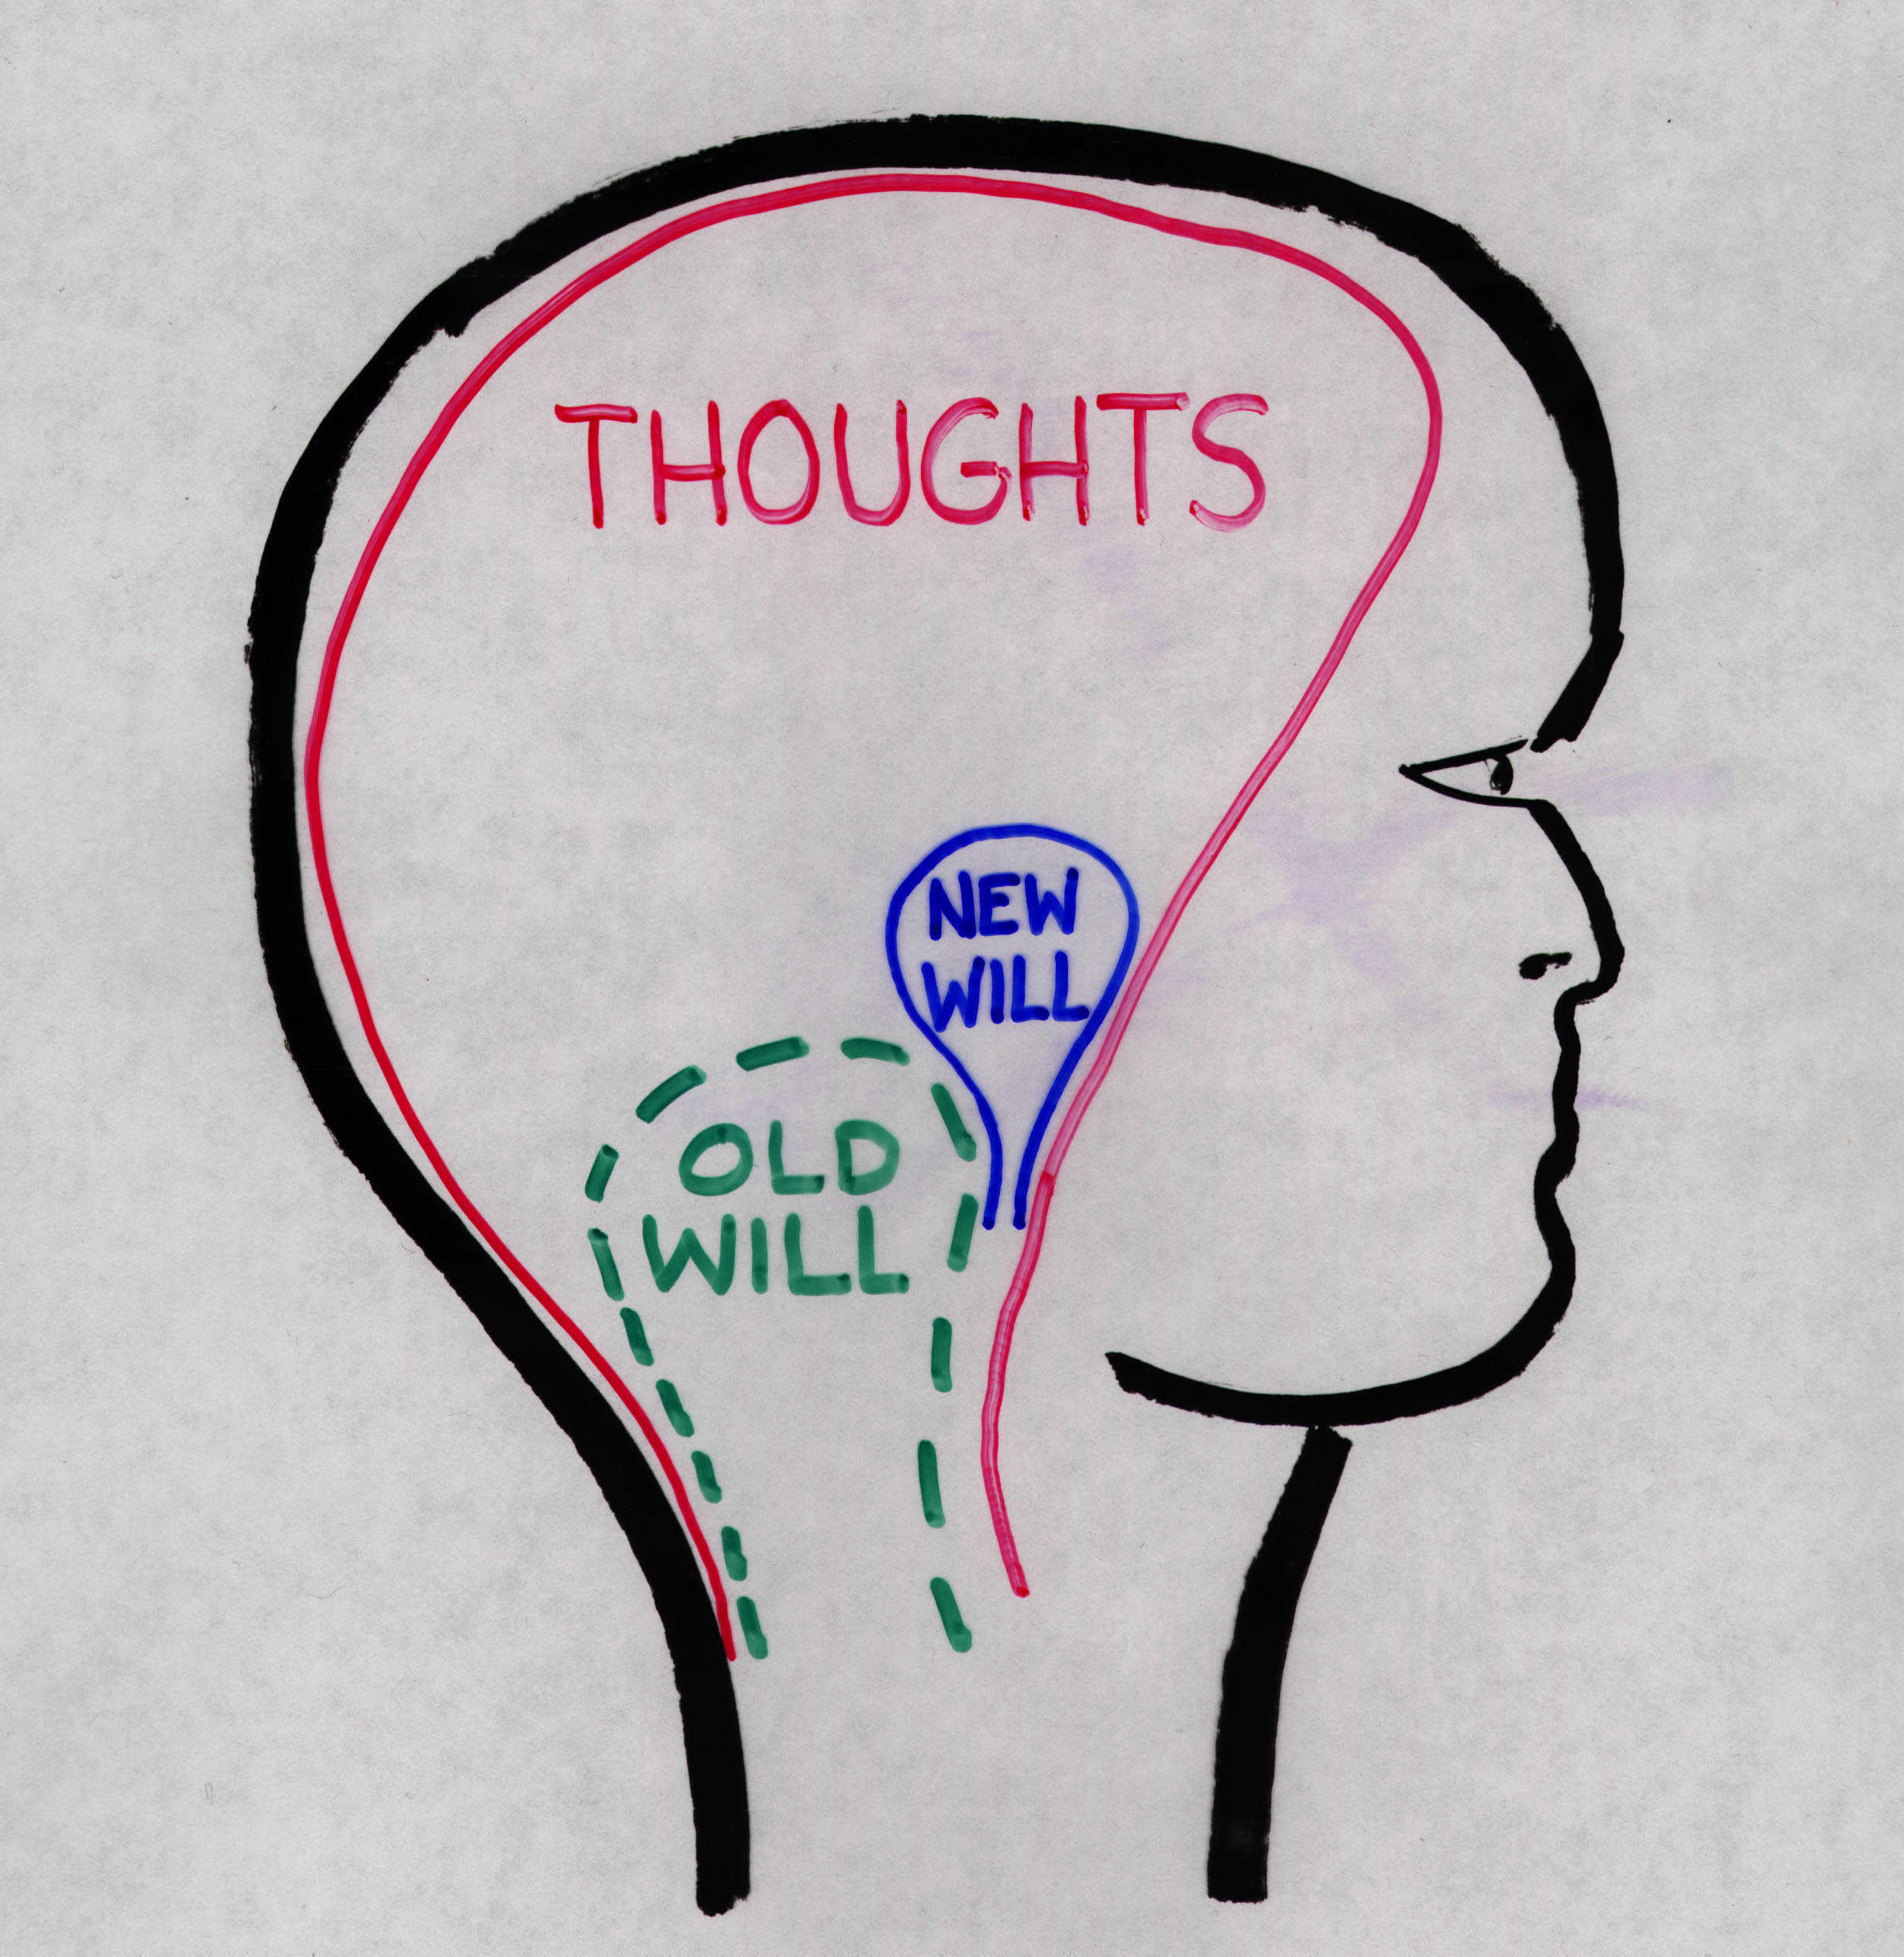

Slide 33
For I know that in me (that is, in my flesh,) dwelleth no good thing: for to will is present with me; but how to perform that which is good I find not. Romans 7:18

Slide 35
Romans 8:5-9
For they that are after the flesh do mind the things of the flesh; but they that are after the Spirit the things of the Spirit.
For to be carnally minded is death; but to be spiritually minded is life and peace.
Because the carnal mind is enmity against God: for it is not subject to the law of God, neither indeed can be.

Slide 36
Romans 8:5-9
So then they that are in the flesh cannot please God.
But ye are not in the flesh, but in the Spirit, if so be that the Spirit of God dwell in you. Now if any man have not the Spirit of Christ, he is none of his.

Slide 37
1Peter 2:11
Dearly beloved, I beseech you as strangers and pilgrims, abstain from fleshly lusts, which war against the soul;

Slide 38
2Corinthians 10:3-5
For though we walk in the flesh, we do not war after the flesh:
(For the weapons of our warfare are not carnal, but mighty through God to the pulling down of strong holds;)
Casting down imaginations, and every high thing that exalteth itself against the knowledge of God, and bringing into captivity every thought to the obedience of Christ;

Slide 39
1Corinthians 9:24-27
Know ye not that they which run in a race run all, but one receiveth the prize? So run, that ye may obtain.
And every man that striveth for the mastery is temperate in all things. Now they do it to obtain a corruptible crown; but we an incorruptible.

Slide 40
1Corinthians 9:24-27
I therefore so run, not as uncertainly; so fight I, not as one that beateth the air:
But I keep under my body, and bring it into subjection: lest that by any means, when I have preached to others, I myself should be a castaway.

Slide 41
James 1:8
A double minded man is unstable in all his ways.

Slide 42
James 1:8; 4:8
A double minded man is unstable in all his ways.
Draw nigh to God, and he will draw nigh to you. Cleanse your hands, ye sinners; and purify your hearts, ye double minded.

Slide 43
Ephesians 6:11,12
Put on the whole armour of God, that ye may be able to stand against the wiles of the devil.
For we wrestle not against flesh and blood, but against principalities, against powers, against the rulers of the darkness of this world, against spiritual wickedness in high places.

Slide 44
1Peter 5:8
Be sober, be vigilant; because your adversary the devil, as a roaring lion, walketh about, seeking whom he may devour.

Slide 45
2 Corinthians 2:11
Lest Satan should get an advantage of us: for we are not ignorant of his devices.

Slide 46
Satan’s Strategies
1. Confusion
2. Contamination

Slide 47
Satan’s Strategies
1. Confusion
“I’m Part of You”
“I’m Already Reckoned Dead”
“The War is Over – Stop Fighting” 2. Contamination

Slide 48
Satan’s Strategies
1. Confusion
“I’m Part of You”
“I’m Already Reckoned Dead”
“The War is Over – Stop Fighting” 2. Contamination

Slide 49
Satan’s Strategies
1. Confusion
“I’m Part of You”
“I’m Already Reckoned Dead”
“The War is Over – Stop Fighting” 2. Contamination

Slide 50
Satan’s Strategies
1. Confusion
“I’m Part of You”
“I’m Already Reckoned Dead”
“The War is Over – Stop Fighting” 2. Contamination

Slide 51
Satan’s Strategies
1. Confusion
“I’m Part of You”
“I’m Already Reckoned Dead”
“The War is Over – Stop Fighting” 2. Contamination

Slide 52
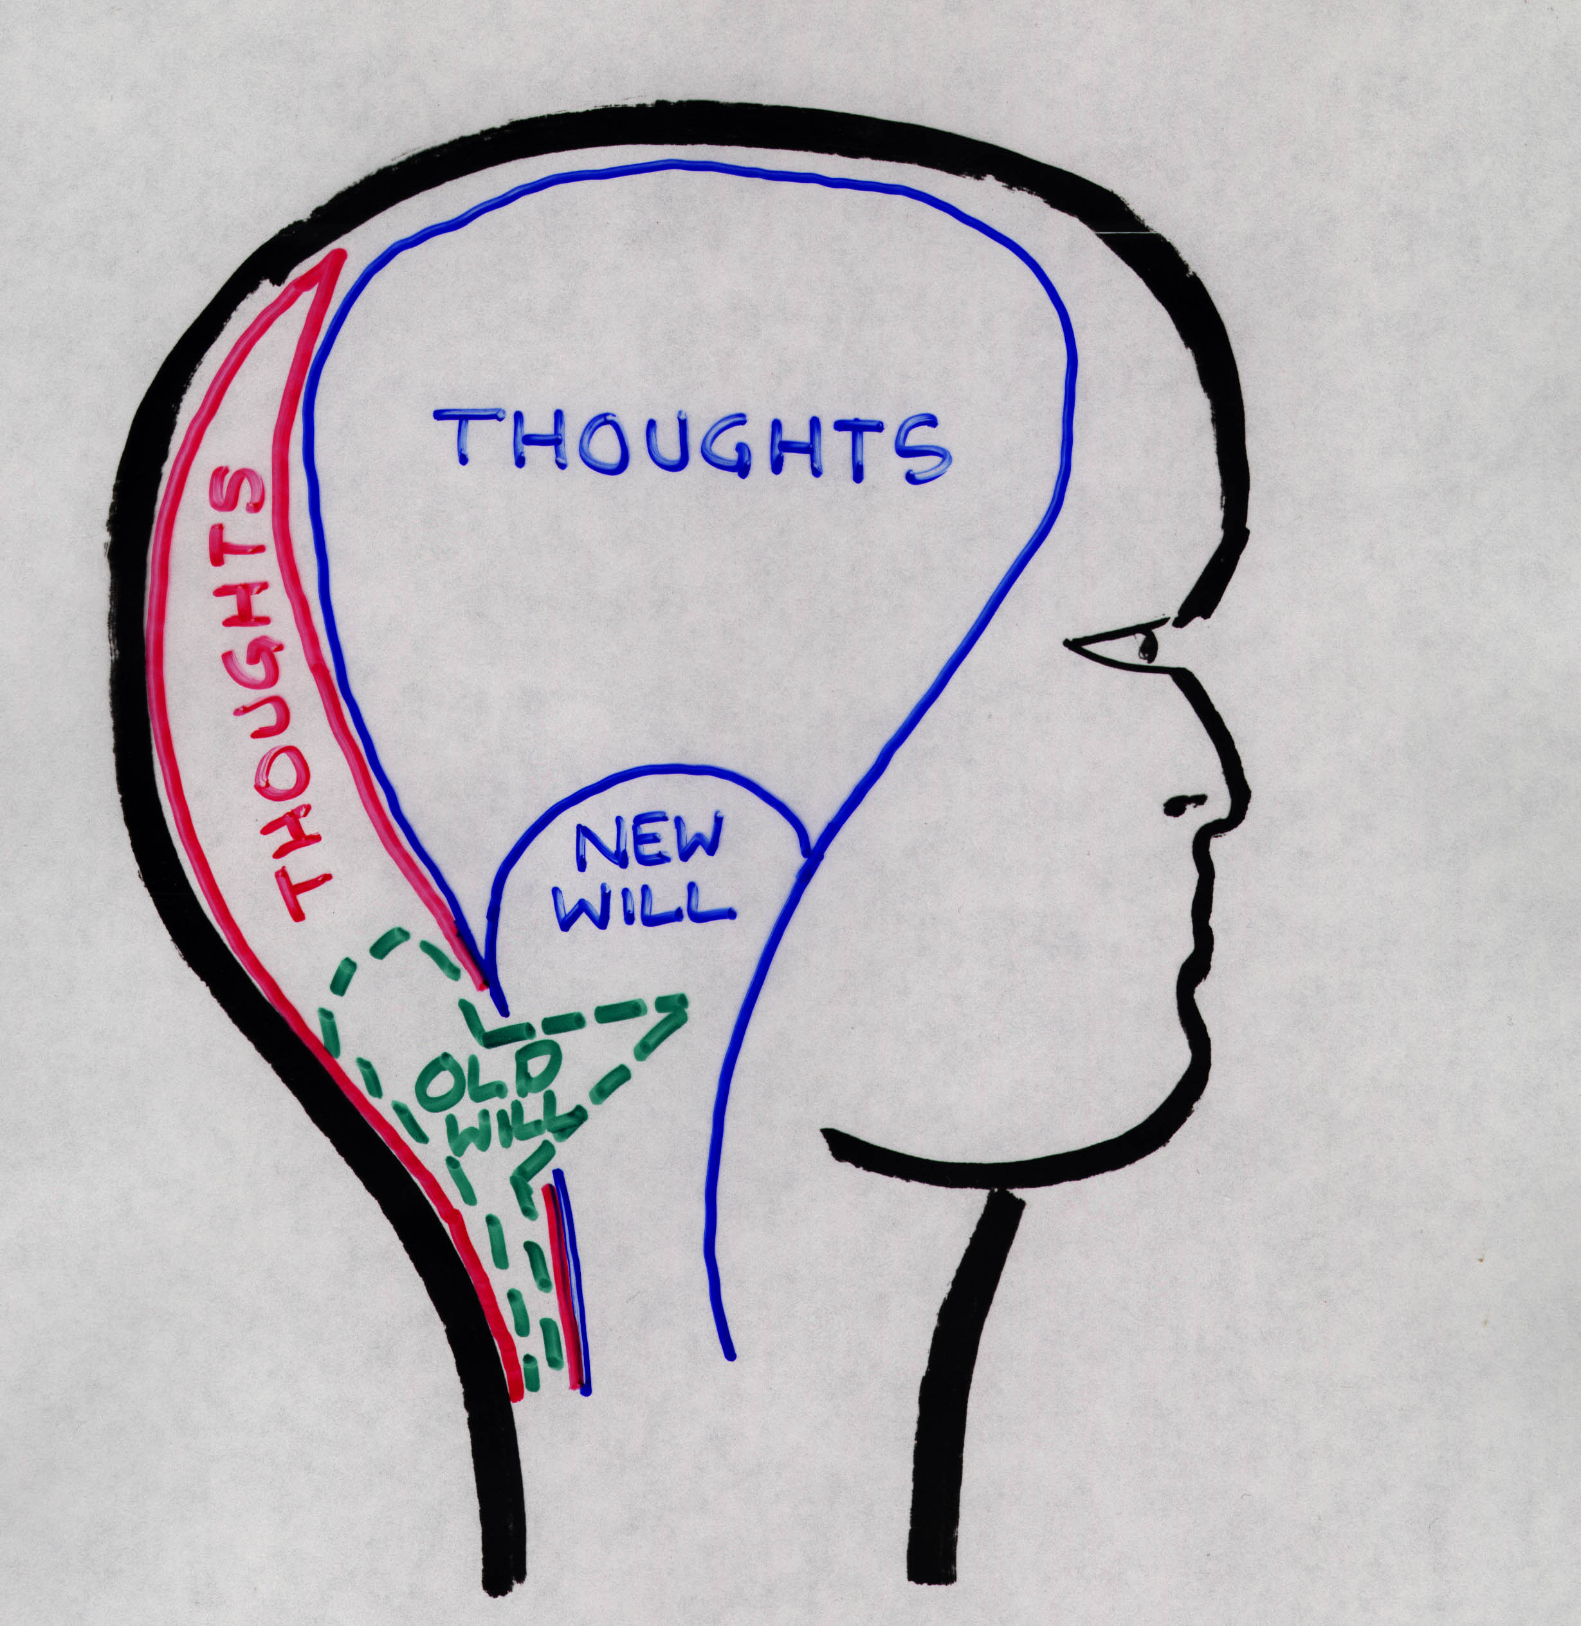

Slide 53
Hebrews 11:25
Choosing rather to suffer affliction with the people of God, than to enjoy the pleasures of sin for a season.

Slide 54
Hebrews 11:25; 1:9
Choosing rather to suffer affliction with the people of God, than to enjoy the pleasures of sin for a season.
Thou hast loved righteousness and hated iniquity; therefore God, even thy God hath anointed thee with the oil of gladness above thy fellows.

Slide 55
Partially Willful Sin - Q507
The New Creature's proper body is the Spirit body of the First Resurrection. But before getting it he is placed on probation and given his old human body to practice with. The New Creature cannot make the old body obey him perfectly. But he can develop strength in his endeavors to bring words, actions and thoughts into perfect accord with the perfect Law of God--Love.

Slide 56
Partially Willful Sin - Q507
The imperfections of the flesh to which the new mind does not consent are all of heredity--all from Adamic weakness-- all, therefore, forgivable by the Redeemer, who merely needs to be appealed to as the great Advocate. But every transgression of the flesh is charged to the New Creature, who owns the flesh and is using it. This obligates repentance, prayer, etc., and means the greater blessing to the New Creature.

Slide 57
Partially Willful Sin - Q507
To whatever extent the New Creature gives consent or sympathy to the sin of his flesh he is worthy of "stripes," which correctively will assist in his character development. "What son is he whom his Father chasteneth not?"

Slide 59
References:
Reprint 5438-5440;
Volume 1 Pages196-202;
Volume 5 Pages179-80, 193-97

Slide 60
Proverbs 4:23
Keep thy heart with all diligence; for out of it are the issues of life.

Slide 61
Proverbs Chapter Four

Slide 62
Proverbs Chapter Four
Verses 1-4: Heed my fatherly advice

Slide 63
Proverbs Chapter Four
Verses 1-4: Heed my fatherly advice
Verses 5-10: Get Wisdom and Understanding

Slide 64
Proverbs Chapter Four
Verses 1-4: Heed my fatherly advice
Verses 5-10: Get Wisdom and Understanding
Verses 11-19: Choose the right paths in life

Slide 65
Proverbs 4:20-27
My son, attend to my words; incline thine ear unto my sayings.
Let them not depart from thine eyes; keep them in the midst of thine heart.
For they are life unto those that find them, and health to all their flesh.
Keep thy heart with all diligence; for out of it are the issues of life.

Slide 66
Proverbs 4:20-27
Put away from thee a froward mouth, and perverse lips put far from thee.
Let thine eyes look right on, and let thine eyelids look straight before thee.
Ponder the path of thy feet, and let all thy ways be established.
Turn not to the right hand nor to the left: remove thy foot from evil.

Slide 67
Proverbs 4:20-27
My son, attend to my words; incline thine ear unto my sayings.
Let them not depart from thine eyes; keep them in the midst of thine heart.
For they are life unto those that find them, and health to all their flesh.
Keep thy heart with all diligence; for out of it are the issues of life.

Slide 68
Proverbs 4:20-27
Put away from thee a froward mouth, and perverse lips put far from thee.
Let thine eyes look right on, and let thine eyelids look straight before thee.
Ponder the path of thy feet, and let all thy ways be established.
Turn not to the right hand nor to the left: remove thy foot from evil.

Slide 71
Satan’s Strategies
1. Confusion
“I’m Part of You”
“I’m Already Reckoned Dead”
“The War is Over – Stop Fighting” 2. Contamination

Slide 72
Worldly Sayings
“A Man is as a man does”

Slide 73
Worldly Sayings
“A Man is as a man does”
. . . You are what you do

Slide 74
Worldly Sayings
“A Man is as a man does”
. . . You are what you do
“You are what you eat”

Slide 75
Worldly Sayings
“A Man is as a man does”
. . . You are what you do
“You are what you eat”
. . . You are what you think!

Slide 76
Worldly Sayings
“A Man is as a man does”
. . . You are what you do
“You are what you eat”
. . . You are what you think!
“It’s All In Your Head”

Slide 77
Worldly Sayings
“A Man is as a man does”
. . . You are what you do
“You are what you eat”
. . . You are what you think!
“It’s All In Your Head”
. . . The Battle of the New Creature!

Slide 78
Convention Theme Text
Keep thy heart with all diligence; for out of it are the issues of life.
Proverbs 4:23

Slide 79
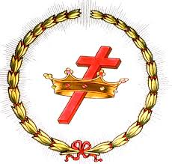
WIN YOUR CROWN!

